Slide 1
Projects and methods for design and development
Marie Sjölinder

Slide 2
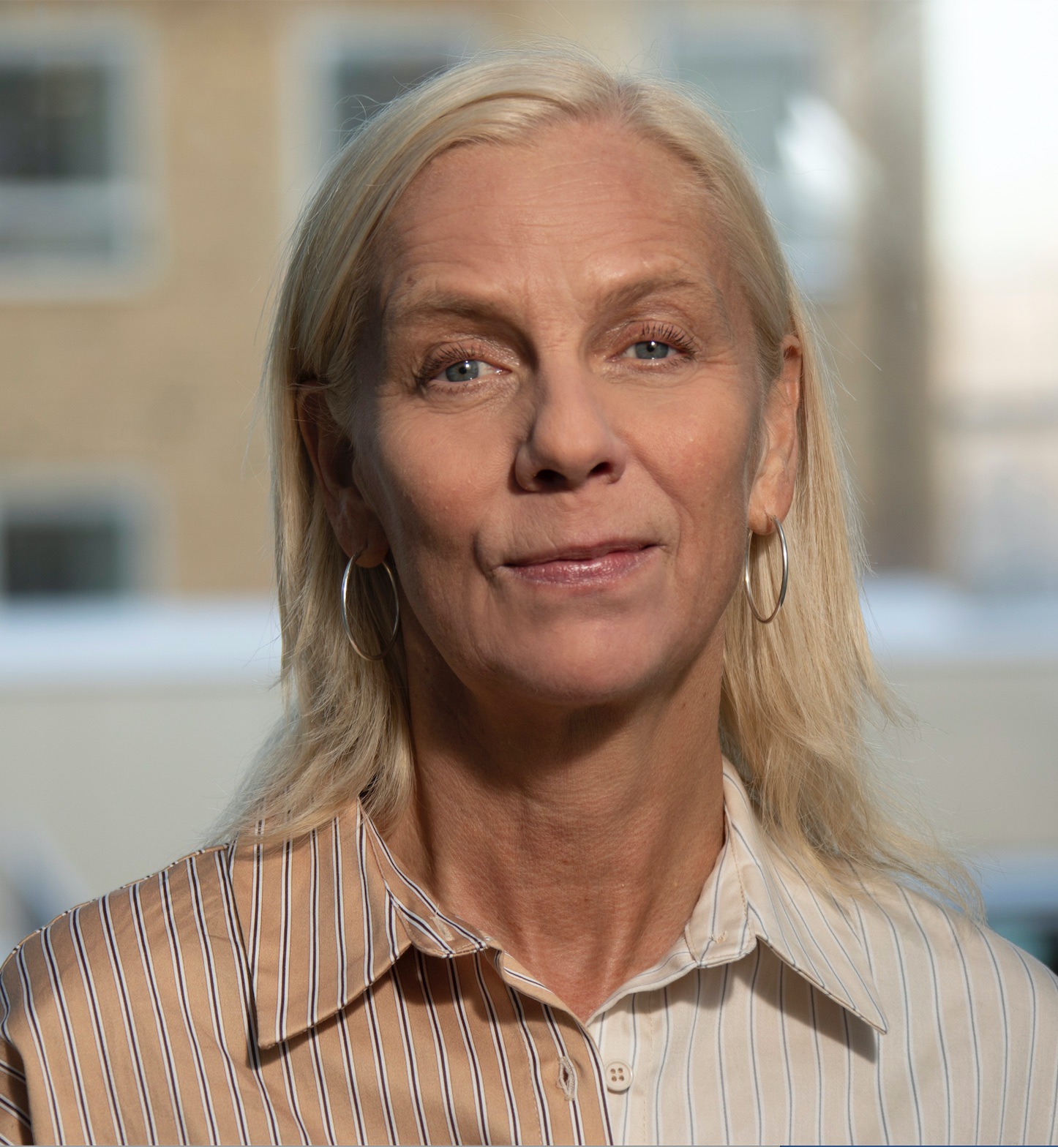
Marie Sjölinder
Researcher at RISE, 20% teaching at MDU
PhD Psychology (usage of technology) and Bachlor in Computer science
Worked at SICS/RISE with applied projects for a super long time

Slide 3
Overview
Previous or ongoing projects at RISE
Methods applied in different contexts
Opportunities and challenges
Research in the projects
Older adults
Tools for supporting rehabilitation
Children
Young adults

Slide 4
Older adults as the target group
Not one target group
Diversity, becoming more diverse as we age
Large age span – man years covered in this vague definition
Larger differences based on socio-economic differences
Stereotypes
Motivation and incentives rather than lack of interest

Slide 5
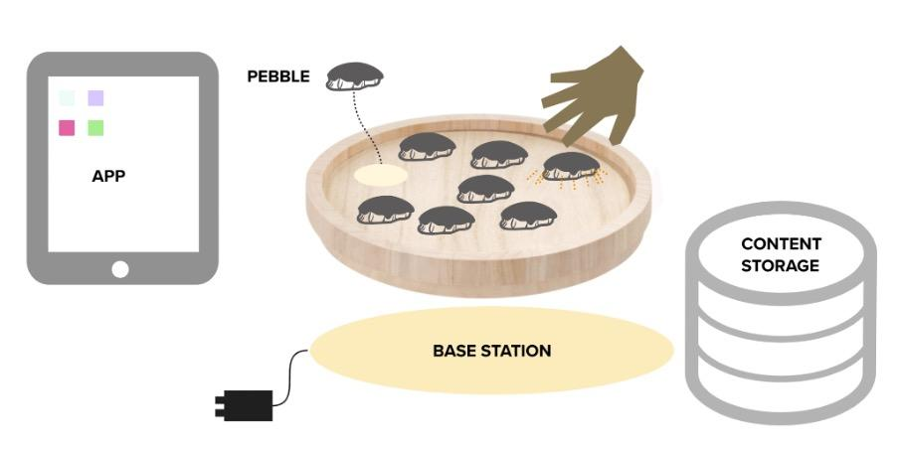
Life Stories
Familjen Kamprads stiftelse, 2022-01-01 - 2024-08-31
Project partners: RISE, Betania stiftelsen, Piteå kommun, Aging 2.0,
Digital solution for gathering life stories - supporting communication between older adults and caregivers/relatives
Based on paper-versions and digital versions where the aim is to gather information about a person’s life and preferences
Aim here - multi-sensor experience, capture both past and present, changes with time, the older adult in control
The interactive solution developed consisted of two parts, one mini-game for gathering information about preferences and interests, and one part where an interactive device was used to present relevant topics for conversation
Iterative development – workshops with different groups and at the end testing the solution
Lesson learnt:
Complex set-up with two steps, needs two participants – older adult and staff/relative, challenge to get participants and to have a similar set-up for all sessions
Started to develop too late – complex technical set-up. So many IRL details that will be a part of the experience - that needs to be iterated a lot!
Balance between nice meetings to get participants and being able to conduct some
kind of systematic research.
Sjölinder, M., Hollström, E., Rönntoft, H., Ståhl, O., Helin, A., Marklund, V. (2024).
Evaluation of an Interactive Solution for Reminiscence and Communication.
In: Jay Kalra (eds) Human Factors in Aging and Special Needs. AHFE (2024)
International Conference. AHFE Open Access, vol 133. AHFE International, USA.
http://doi.org/10.54941/ahfe1004890

Slide 6
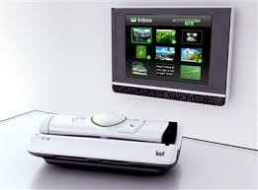
Ippi
Together with the company In View, 2010-2012
Interaction with apps using the TV as a larger screen
Develop new services for their product
Older adults of different ages – nursing homes and living on their own
Nursing homes – gate keepers – wrong target group
After some time – insights – new context of usage
Younger older adults – same group of participants – important with social context and that they get something out of their participation
Working close together with the company and the younger group of older adults
Prioritization matrix – most needed and possible to develop
Research: Methods for user involvement, feasibility study, how to meet the needs of all stakeholders (including the company)
Sjölinder M., Scandurra I., Avatare Nöu A., Kolkowska E. (2016). To Meet the Needs of Aging Users and the Prerequisites of Innovators in the Design Process. In: Zhou J., Salvendy G. (eds) Human Aspects of IT for the Aged Population. Design for Aging. ITAP 2016. Lecture Notes in Computer Science, vol 9754. Springer, Cham
Sjölinder M & Scandurra I. (2015). Effects of Using Care Professionals in the Development
of Social Technology for Elderly. In Human Aspects of IT for the Aged Population.
Design for Everyday Life. LNCS Vol 9194, pp 181-192, 2015 First International Conference,
ITAP 2015, Held as Part of HCI International 2015, Los Angeles, CA, USA, August 2-7, 2015.

Slide 7
Questions – thoughts?

Slide 8
Rehabilitation
Vulnerable groups
Challenging period in life
Have to adapt to their situation
Patient groups – representatives – engaged but are they representing the majority in that group?
Long-term benefits and motivation

Slide 9
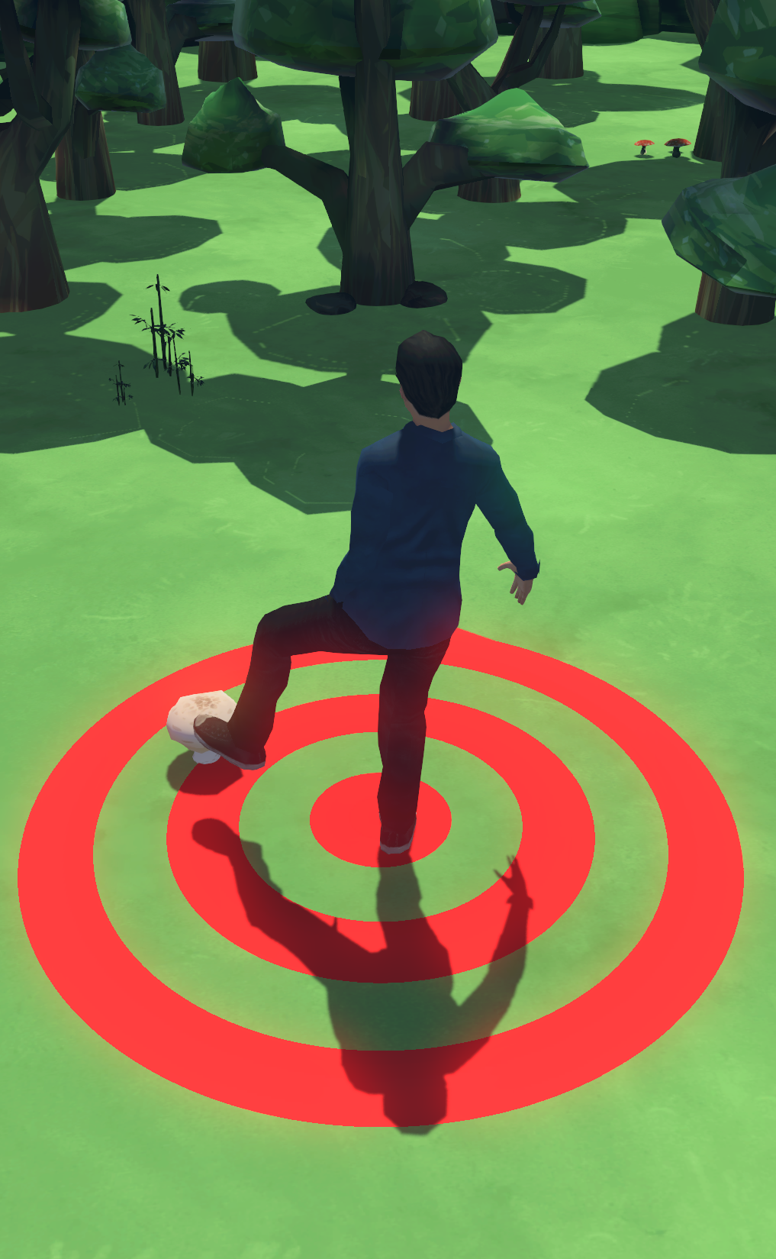
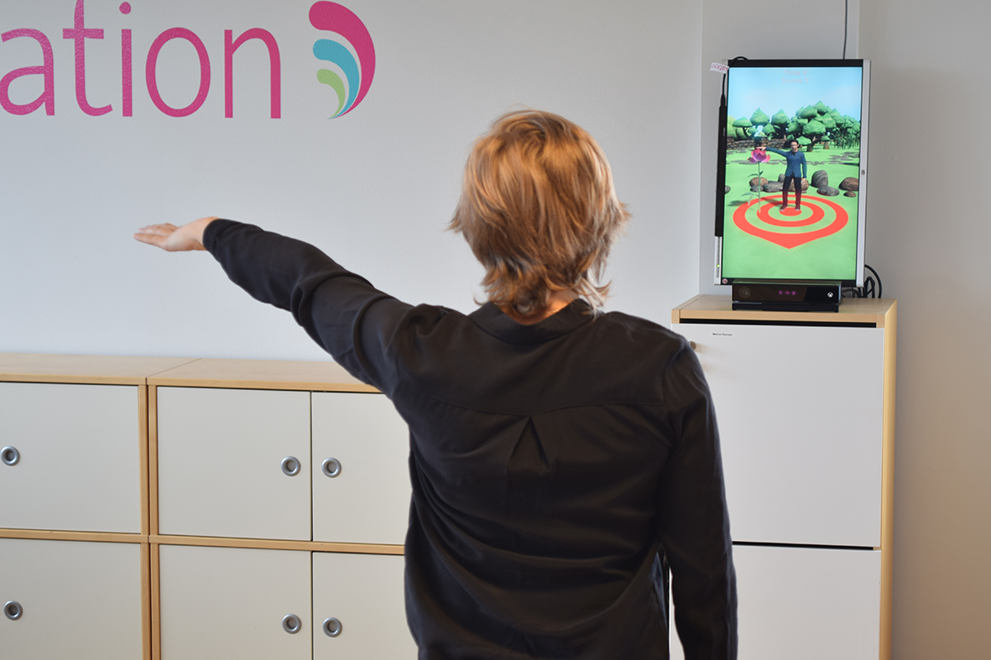
Strada
Robotdalen, Alkit Communications and IUS innovation, Danderyds sjukhus, Västmanland county council, Västerås municipality, Örebro county council, Örebro municipality
2012-2015, several projects
Remote stroke rehabilitation – gamification, Kinect
User involvement:
workshops with physiotherapists and occupational therapists
Iterative testing with users
Research: usage, feasibility, methods for user involvement
Lessons learnt:
Development – expectations in relationship to budget
Multi-stakeholder – advantages and disadvantages of mixing different user groups and professions (roles, hierarchy, vulnerability etc)
Practical issues in the user’s homes, roles and responsibilities
Sjölinder, M., Ehn, M., Boman, I-L., Folke, M., Hansson, P., Sommerfeld, D. K., Nylander, S. & Borg, J. (2014).
A multidisciplinary approach in the development of a stroke rehabilitation tool. Proceedings of HCI
International 2014, 22 - 27 June, Crete, Greece.
Ehn M, Hansson P, Sjölinder M, Boman IL, Folke M, Sommerfeld D, Borg J, Palmcrantz S (2015). Users
Perspectives on interactive distance technology enabling home-based motor training for stroke patients.
Studies in Health Technology and Informatics, 211:145-152.

Slide 10
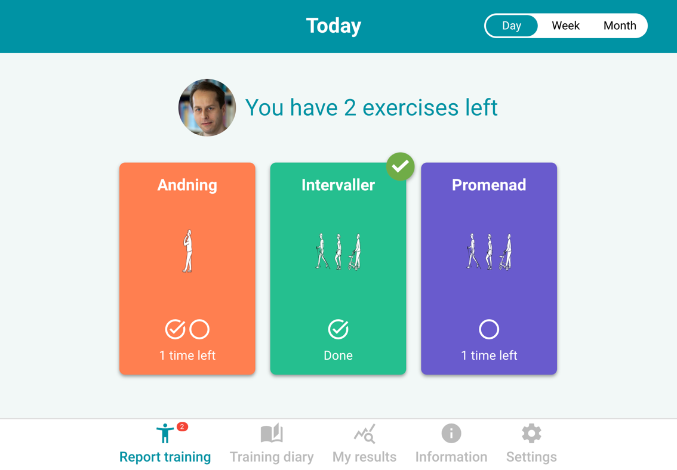
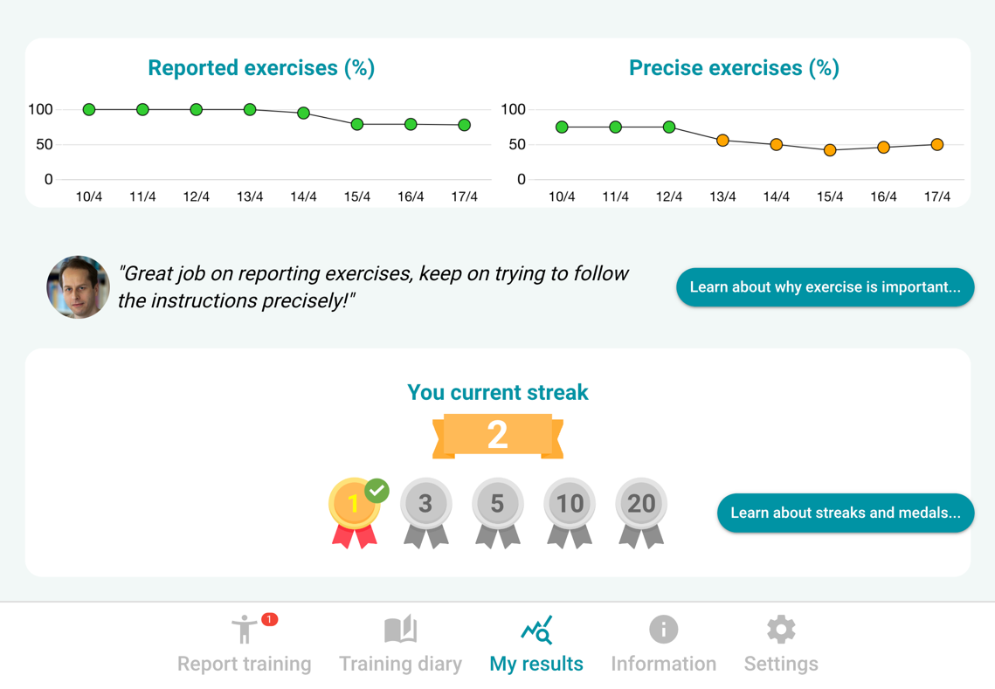
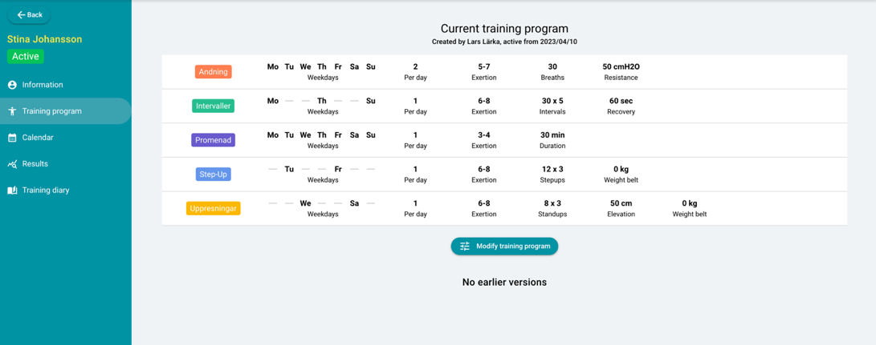
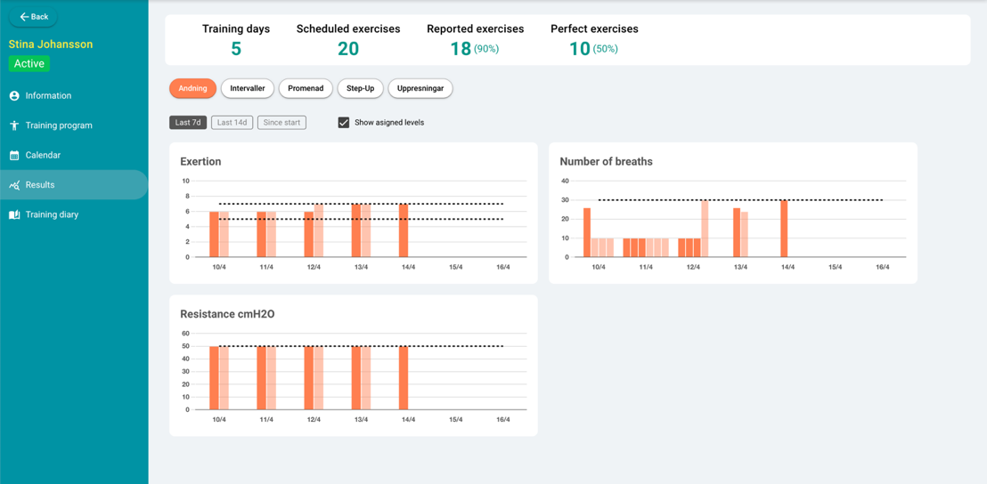
PoPEx
KI, 2021 – ongoing
Design of an mHealth Application for Optimizing Preoperative Physical Function
Shorter time between diagnosis and surgery, more important to focus on the effects of a short exercise program with high intensity and frequency
Develop an application with two separate end user applications, one web application for physiotherapists, and one mobile (tablet) application for patients
The detailed features of the application were defined together with users during a co-creation process in workshops
Repeated workshops with the same group of patients
Dedicated group, social advantages
Possibility to follow the development, less new input
Ongoing study at KI – feasibility study, and published paper about the iterative development
Sjölinder, M., Ståhl, O., Rydwik, E., Torikka, S. (2023). Design of an mHealth application for optimizing
preoperative physical function. In: Tareq Ahram and Redha Taiar (eds) Human Interaction & Emerging
Technologies (IHIET 2023): Artificial Intelligence & Future Applications. AHFE (2023) International
Conference. AHFE Open Access, vol 0. AHFE International, USA.http://doi.org/10.54941/ahfe1004083

Slide 11
Questions – thoughts?

Slide 12
Children as the target group
Two projects – developing tools targeted towards children
Preparing children for MRI-procedure
Distraction from painful procedures
Tools that need to work in a workflow, staff as a user group as well
Parents also important – support, could affect the child etc

Slide 13
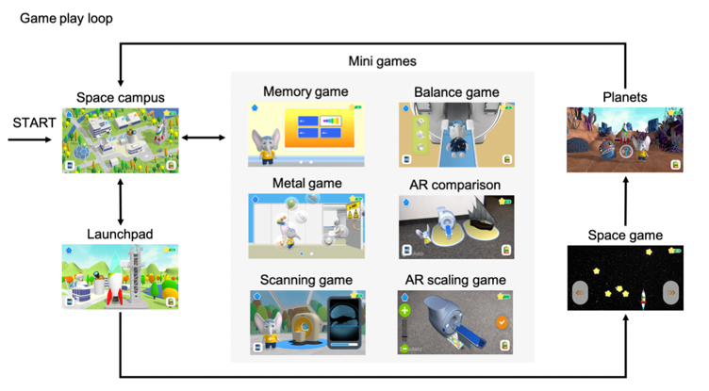
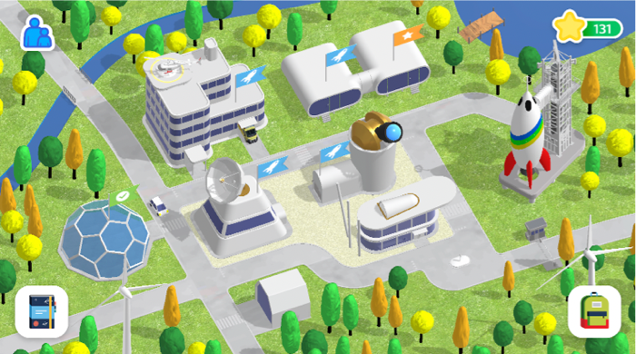
COSMO@Home
Parter: KU Leuven, Philips, RISE, RWTH Aachen University, 2019-2021
Undergoing an MRI-scan could be a challenge – especially for young children:
They have to enter a small tunnel in a large unfamiliar machine
They have to lay perfectly still for 10-40 minutes
COSMO@Home – app with minigames where the goal is to prepare the child for the MRI-scanning procedure
Development/design focusing on achieving a set of learning goals:
Explain the procedure
Familiarization with MRI sounds
Familiarization with size of the MRI machine (it is big)
Practice the timings (it takes very long)
Practice lying still
Learn about accessories (earplugs, head coil etc)
Understand metals
Iterative testing with children at the hospital
Challenge to establish a clear connection between the games and the learning goals
Continuous work with both development to achieve the learning goals but also how to measure the learning goals
Small children, heavy tablet, short texts and texts also needs to be spoken
Hard to practice and achieve the learning goal of laying still
Sjölinder, M., et al. (2021). The COSMO@Home Application – Iterative Development and
Implementation of the Learning Goals. The Fourteenth International Conference on
Advances in Computer-Human Interactions - ACHI 2021, July 17-22, 2021, Nice, France.

Slide 14
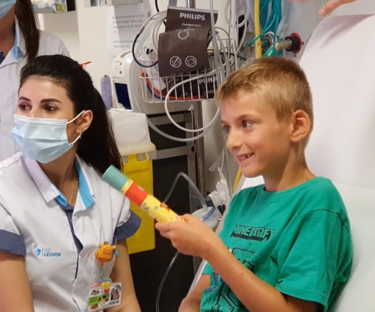
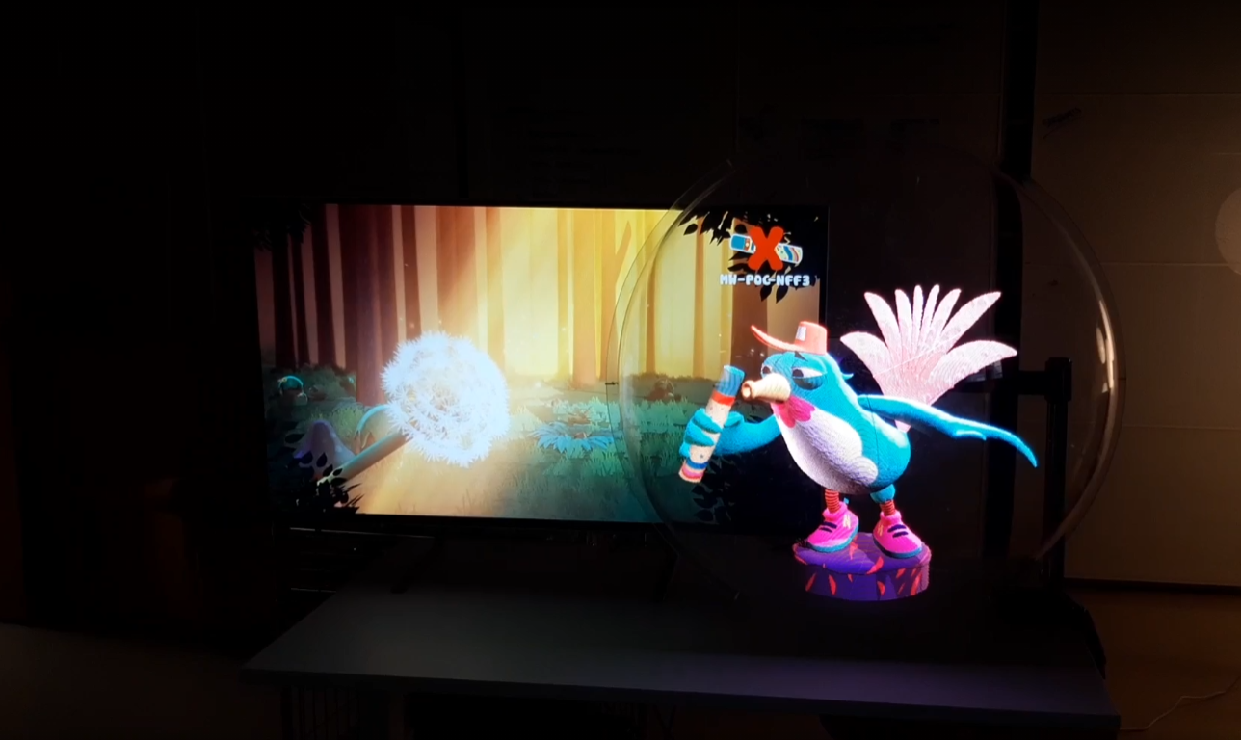
Little NIRVANA - Needle
Parter: KU Leuven, RISE, Philips, Maastricht University Medical Center, Cognuse, University of Tartu, Maastricht University, 2020-2022, 2023-2024, 2025-2027
Little-Nirvana – immersive experience for distracting children during painful procedures
The purpose of Little NIRVANA is to reduce unpleasant experiences associated with medical treatments at hospitals
The solution consists of a games and experiences that children can engage in as a distraction
Interaction with a specially designed input device – a "magic wand, a large screen, and holographic display
A study will start this year with 1200 children

Slide 15
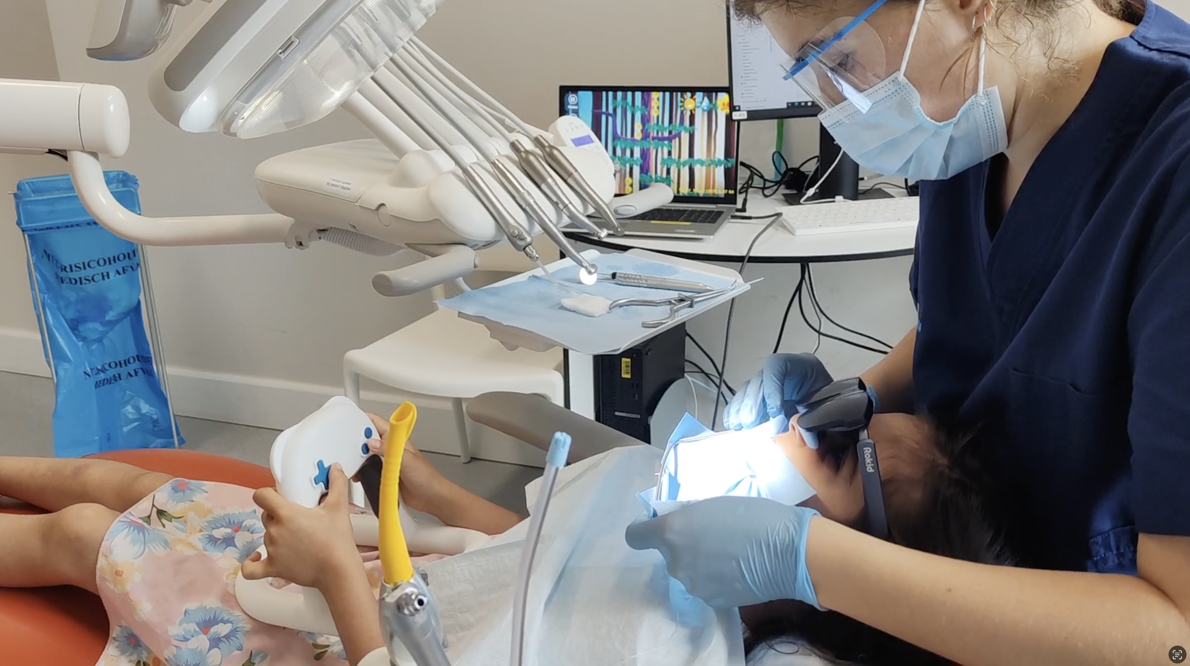
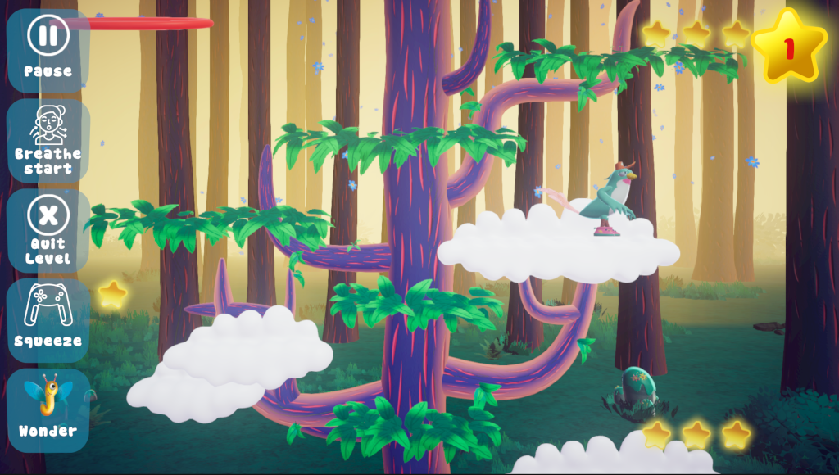
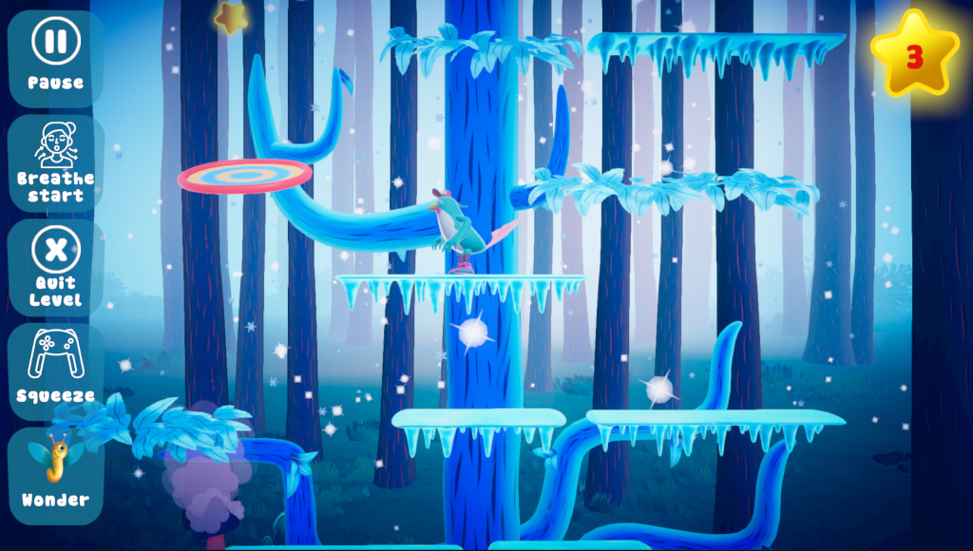
Little Nirvana - Dental
Extension of Nirvana – Needle (ongoing)
AR-glasses and an interaction device for breathing
Adapting the game to using two hands
Challenges with developing new hardware capturing breathing movements, children of different ages and sizes.
Games that are both easy and challenging

Slide 16
Questions – thoughts?

Slide 17
Young adults as the target group
One project – a tool for supporting people with eating disorders
One project – applying “Design Fiction”
Projects in very different contexts
Maybe not possible to group either - people are different

Slide 18
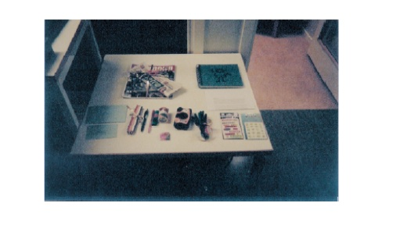
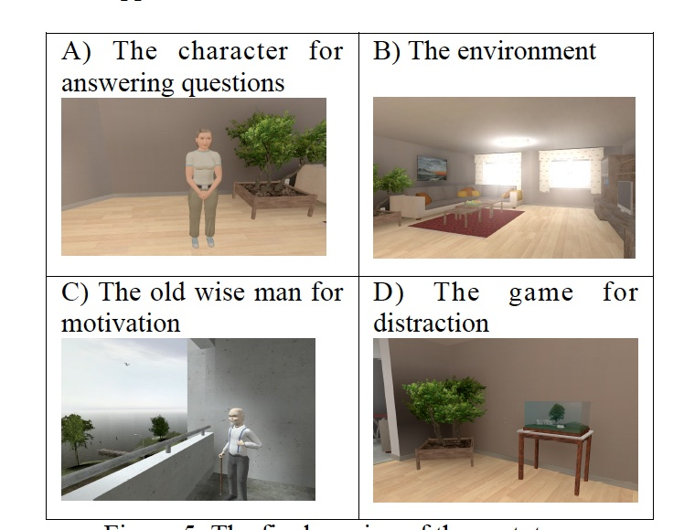
KARMA – Developing a tool for patients with eating disorders
Together with AB Mando, 2010
Design goals based on needs from the patients:
Providing an artificial case manager
Increasing motivation
Providing distraction
Providing an appealing environment
User needs – Cultural Probes (Gaver et al., 1999) box with items to use to capture their daily life or things they liked – fun to participate, free to do chose what to do – challenge to use the input for the solution
Creating characters – iterative process together with a designer – ended up with a stereotypic look
Developing the dialogue – Wizzard of Oz studies – appreciated to be anonymous – ethical aspects
Sjölinder, M., Jansson, L., Höök, K., Laaksolahti, J., Bergh, C., Södersten, P., & Zandian, M. (2010).
User involvement of patients with eating disorder – the design process from user needs to prototype.
ICEHST 2010 - International Conference on e-Health Services and Technologies, July 29-31, 2010,
University of Piraeus, Athens, Greece.

Slide 19
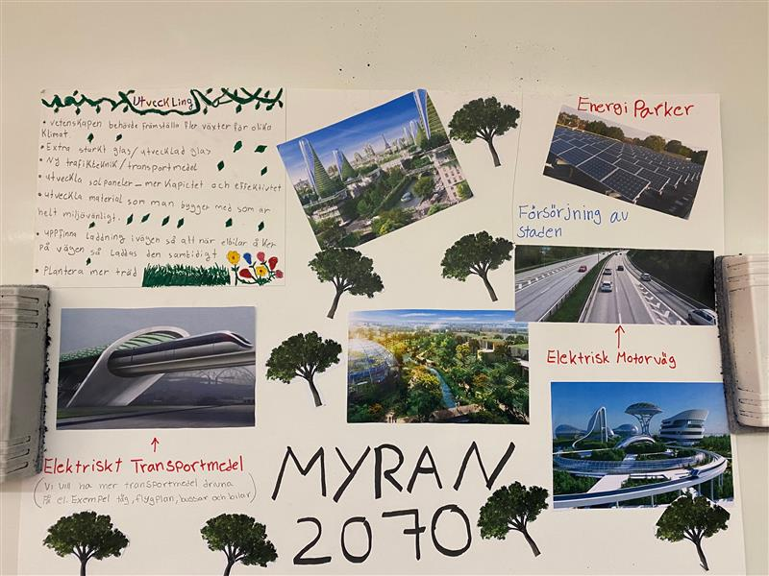
Designing a Future City – Applying Design Fiction with High School students
2019-2022 – Part of the project Sustainable cities – Enköping, 2019-2022
Design Fiction is a mix of science, fact, design, and science fiction (Bleeker, 2009)
Method to explore future possible scenarios and to identify the steps needed to get there (Wakkary et al., 2013)
To explore if and how high school students could apply and use the method Design Fiction
Six final year students wrote their finishing Grade essay within the project with a focus on novel solutions to environmental challenges
The students first participated in a Design Fiction workshop and then arranged workshops themselves with first-year students
The final year students wrote a short text about learning about and using the method:
They learnt a lot and it went over their expectations
They were impressed by the first-year students’ ideas
Reflections about applying the method:
Some students in some of the groups did not contribute since they thought the task was difficult
In some of the groups, the participants used ideas from internet instead of exploring their own ideas
Meaningful and knowledge generating way of working with design with the final year students
Sjölinder M., Söderberg, J. (2022). Designing a Future City – Applying Design Fiction
with High School Students. In proceedings of IHIET 2022 (8th International Conference
on Human Interaction & Emerging Technologies) August 22-24, 2022, Nice, France.

Slide 20
Questions – thoughts?

Slide 21
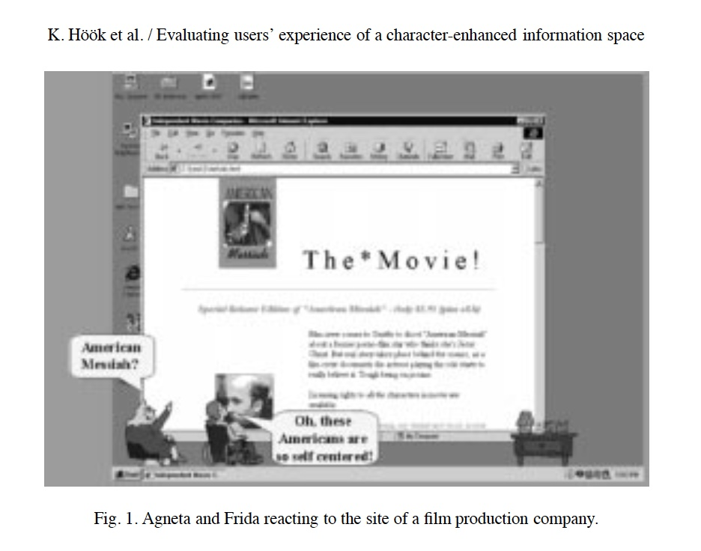
Conclusions
In applied projects – balance between user needs, cost/context for the company, research and the users’ situation
Chose and apply methods based on the context
Change and adapt the methods – better to adjust than get nothing out if
The users/participants must get something out of it and have a good time
AND from an evaluation perspective - never measure laughs per minute – it does not work….

Slide 22
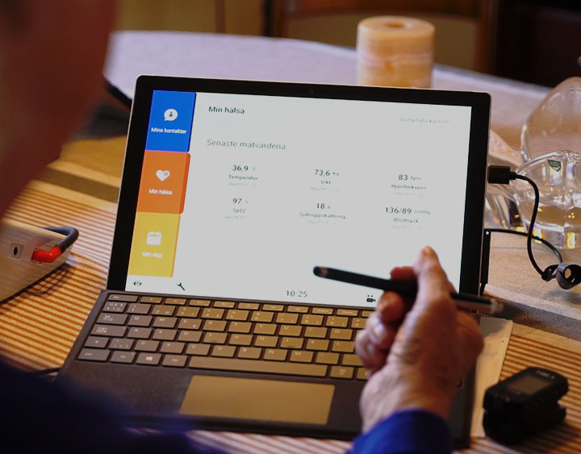
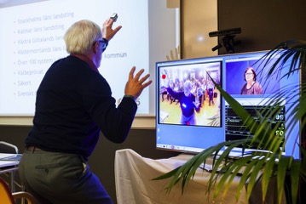
COPD
Together with KI/KS, Alkit communication
Monitoring and physical activity for COPD patients
Monitoring and video communication with GP
Vulnerable group – plan the workshops based on their health
Patient organisation –engaged - but are the participants represent the population?

Slide 23
Home Hospital

